Slide 1
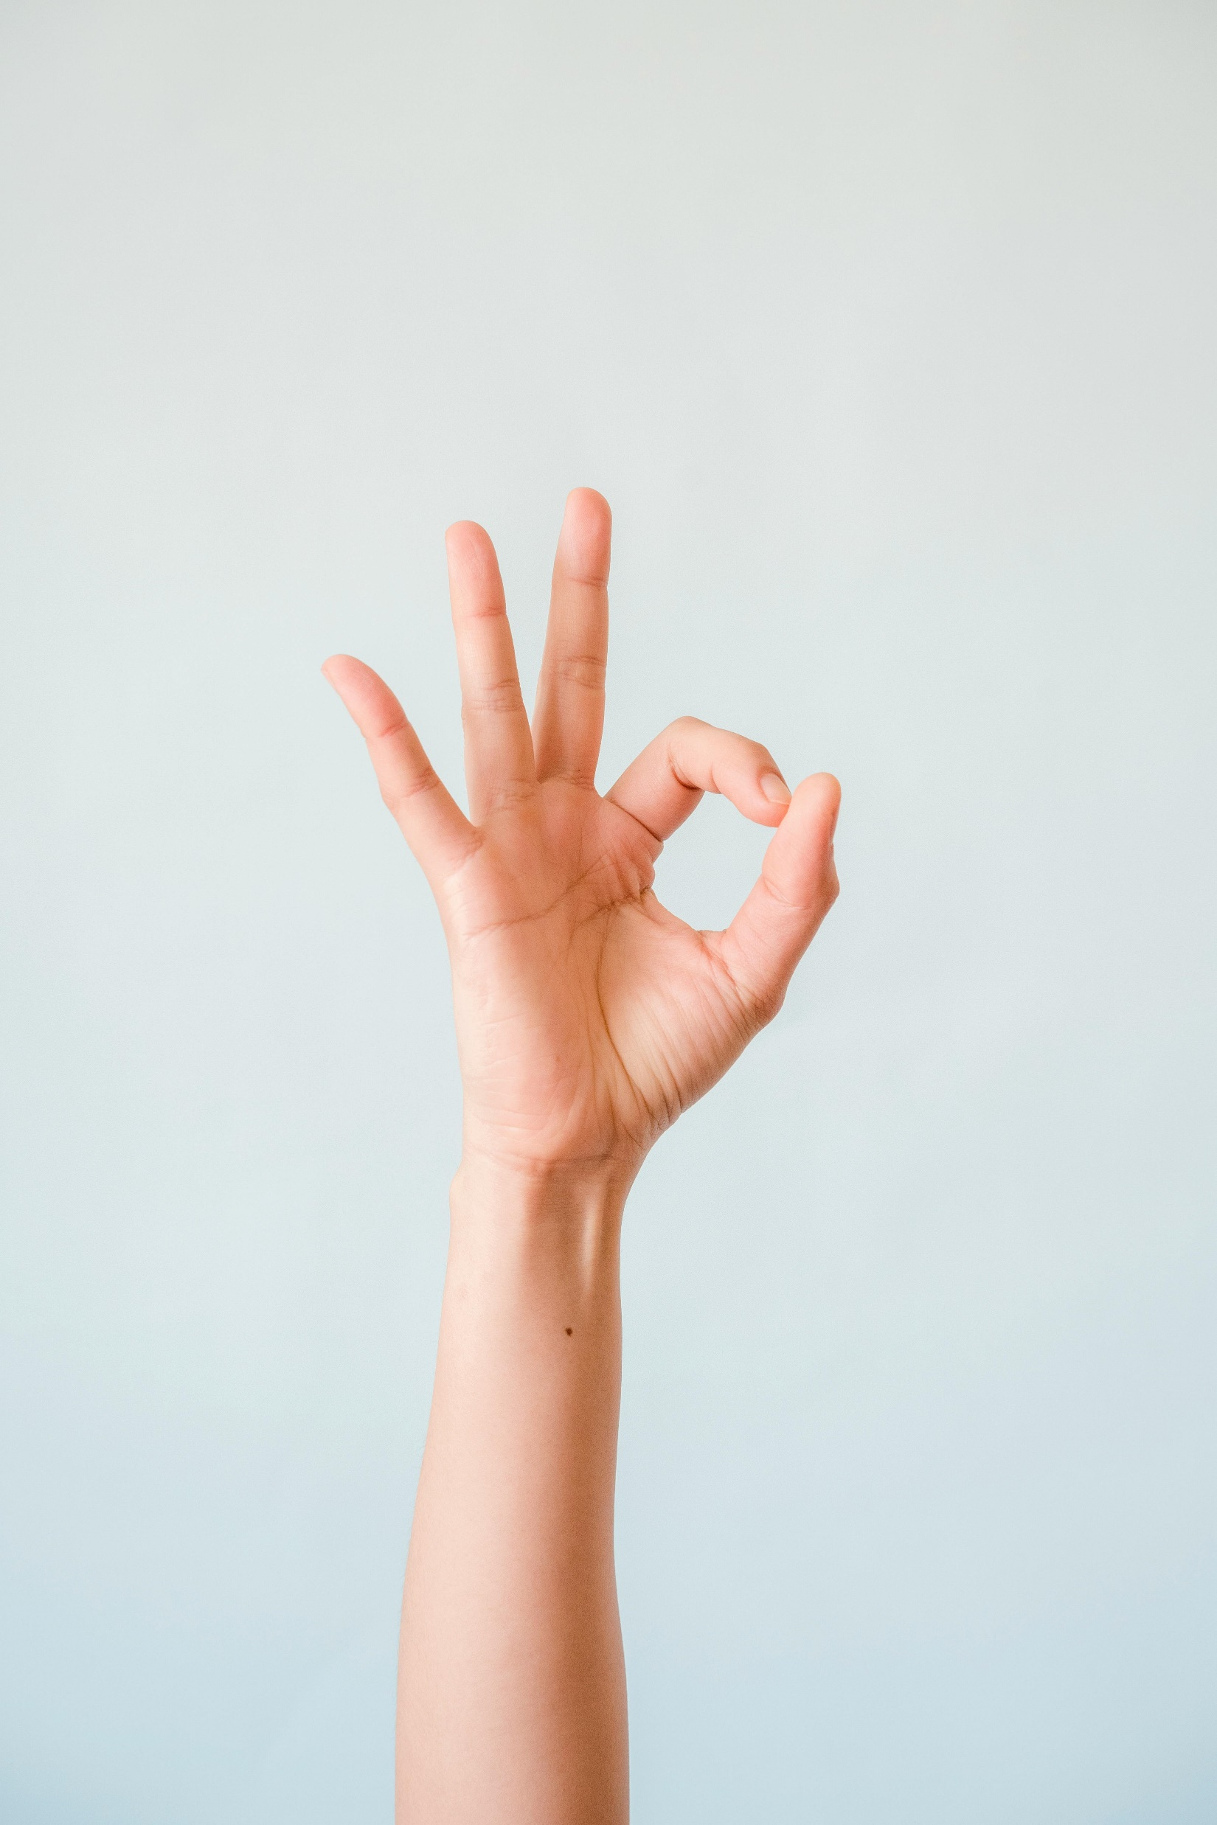
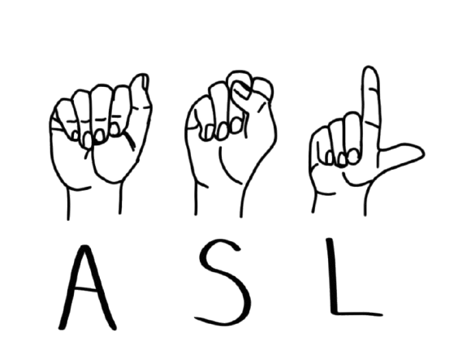
Real-Time Hand Gesture Recognition For ‘ASL’
Using ML
Prepared By:
Shubham Rana
B.Tech CSE (3rd Semester)
Guided By:
Mr. Sanjay Roka
(Assistant Professor)

Slide 2

Introduction
Our project focuses to develop a computer application and train a ML model which when shown the real-time hand gestures of American Sign Language (ASL), shows the meaning for that particular sign amongst 26 different English language alphabets, on screen.

Slide 3

The primary problem addressed by this project is the communication barrier between individuals which rely on ASL and for those who are not familiar with it. This barrier can lead to significant challenges in social, educational, and professional interactions, limiting opportunities and inclusivity for the deaf and hard-of-hearing community. Existing solutions for sign language interpretation, such as human interpreters, are not always readily available, affordable, or practical in every scenario.
Problem Statement

Slide 4
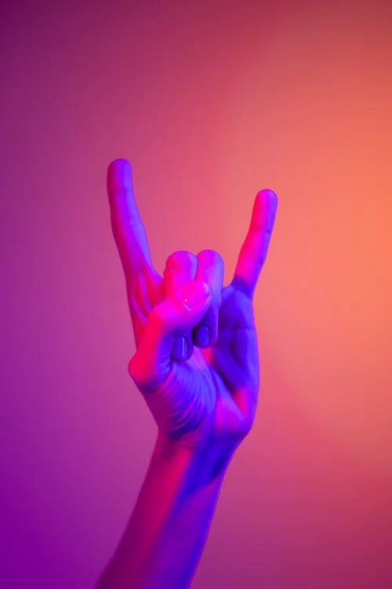
Methodology
The methodology involves the following steps:
DATA COLLECTION
DATA PREPROCESSING
MODEL TRAINING
MODEL TESTING

Slide 5
Data Collection
Captures real-time images of hand gestures using a webcam.
Organizes the captures images into labelled directories for each class (A-Z).
Ensures a large and diverse dataset by capturing multiple samples for each gesture.

Slide 6
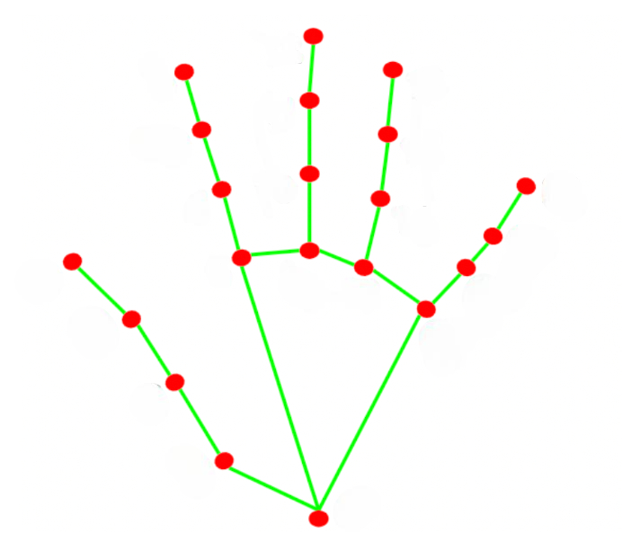
Data Preprocessing
This step can also be referred as ‘Feature Extraction’ or ‘Dataset Creation’.
Mediapipe Hands (a mediapipe solution) is used to extract key hand landmarks from each frame captured by the webcam.
Each landmark consists of normalized (x, y) coordinates, resulting in 42 features (21 landmarks × coordinates), and stores them as feature vectors.
This pre-processed data (landmarks) serves as input for gesture classification, avoiding the need for traditional methods.

Slide 7
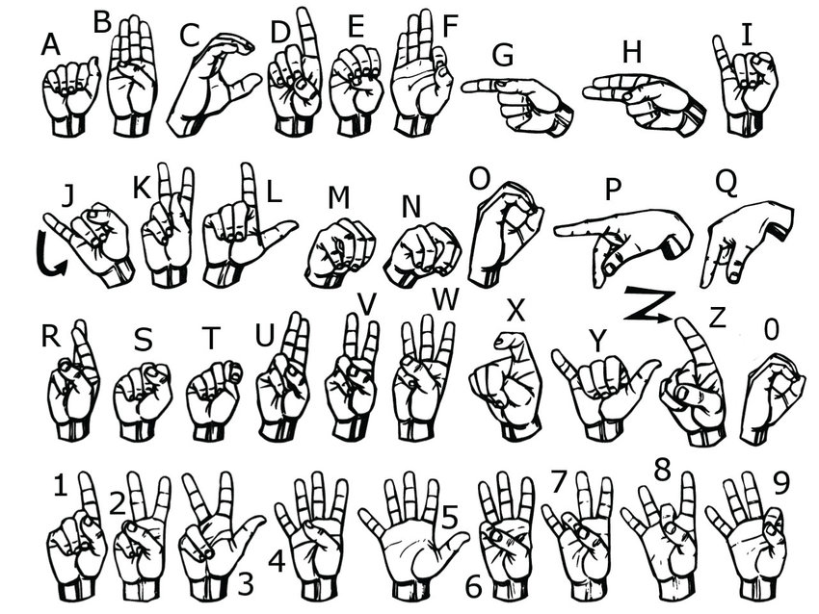
Model Training
Employs a Random Forest Classifier (a ML algorithm) to train on the extracted hand landmark features.
Its main purpose is to split the dataset into training and testing subsets: one for training the ML model and other for testing the model’s performance.

Slide 8
Model Testing and Prediction
Integrates the trained model to predict gestures in real-time using live webcam input.
Combines predictions with accuracy scores and overlays them on the webcam feed for visualization.

Slide 9
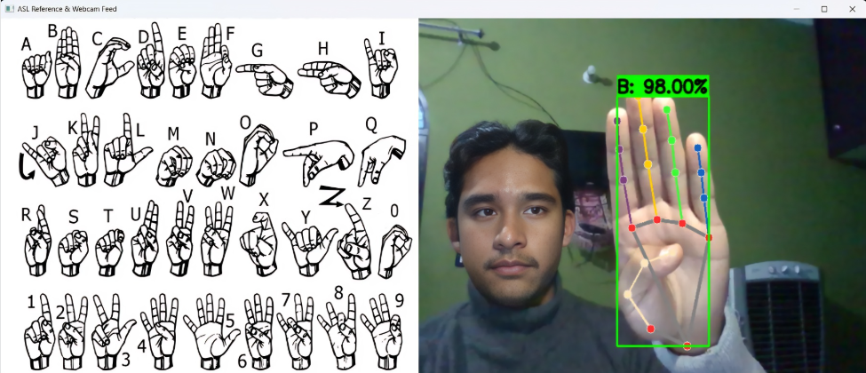
The primary objective of this project was to design and implement a machine learning-based system for recognizing American Sign Language (ASL) gestures, and this objective was well achieved with a satisfactory accuracy.
Result

Slide 10
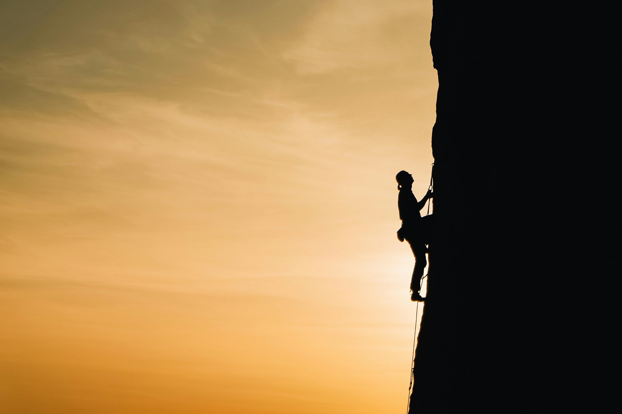
Challenges
The challenges throughout the making of project were:
I couldn’t find a dataset with homogenous attributes resulting to errors while training model, hence I decided to make my own dataset.
Issues were faced related to the prediction accuracy which later was solved by increasing the size of dataset.
One challenge was handling images where no hand or multiple hands were detected during data collection and ensuring data consistency across classes.
Balancing the dataset to ensure equal representation of all gesture classes avoiding overfitting
Real-time recognition accuracy by variations in hand orientation, lighting, background, and occlusions(i.e. condition where the image is partially hidden or obstructed).

Slide 11
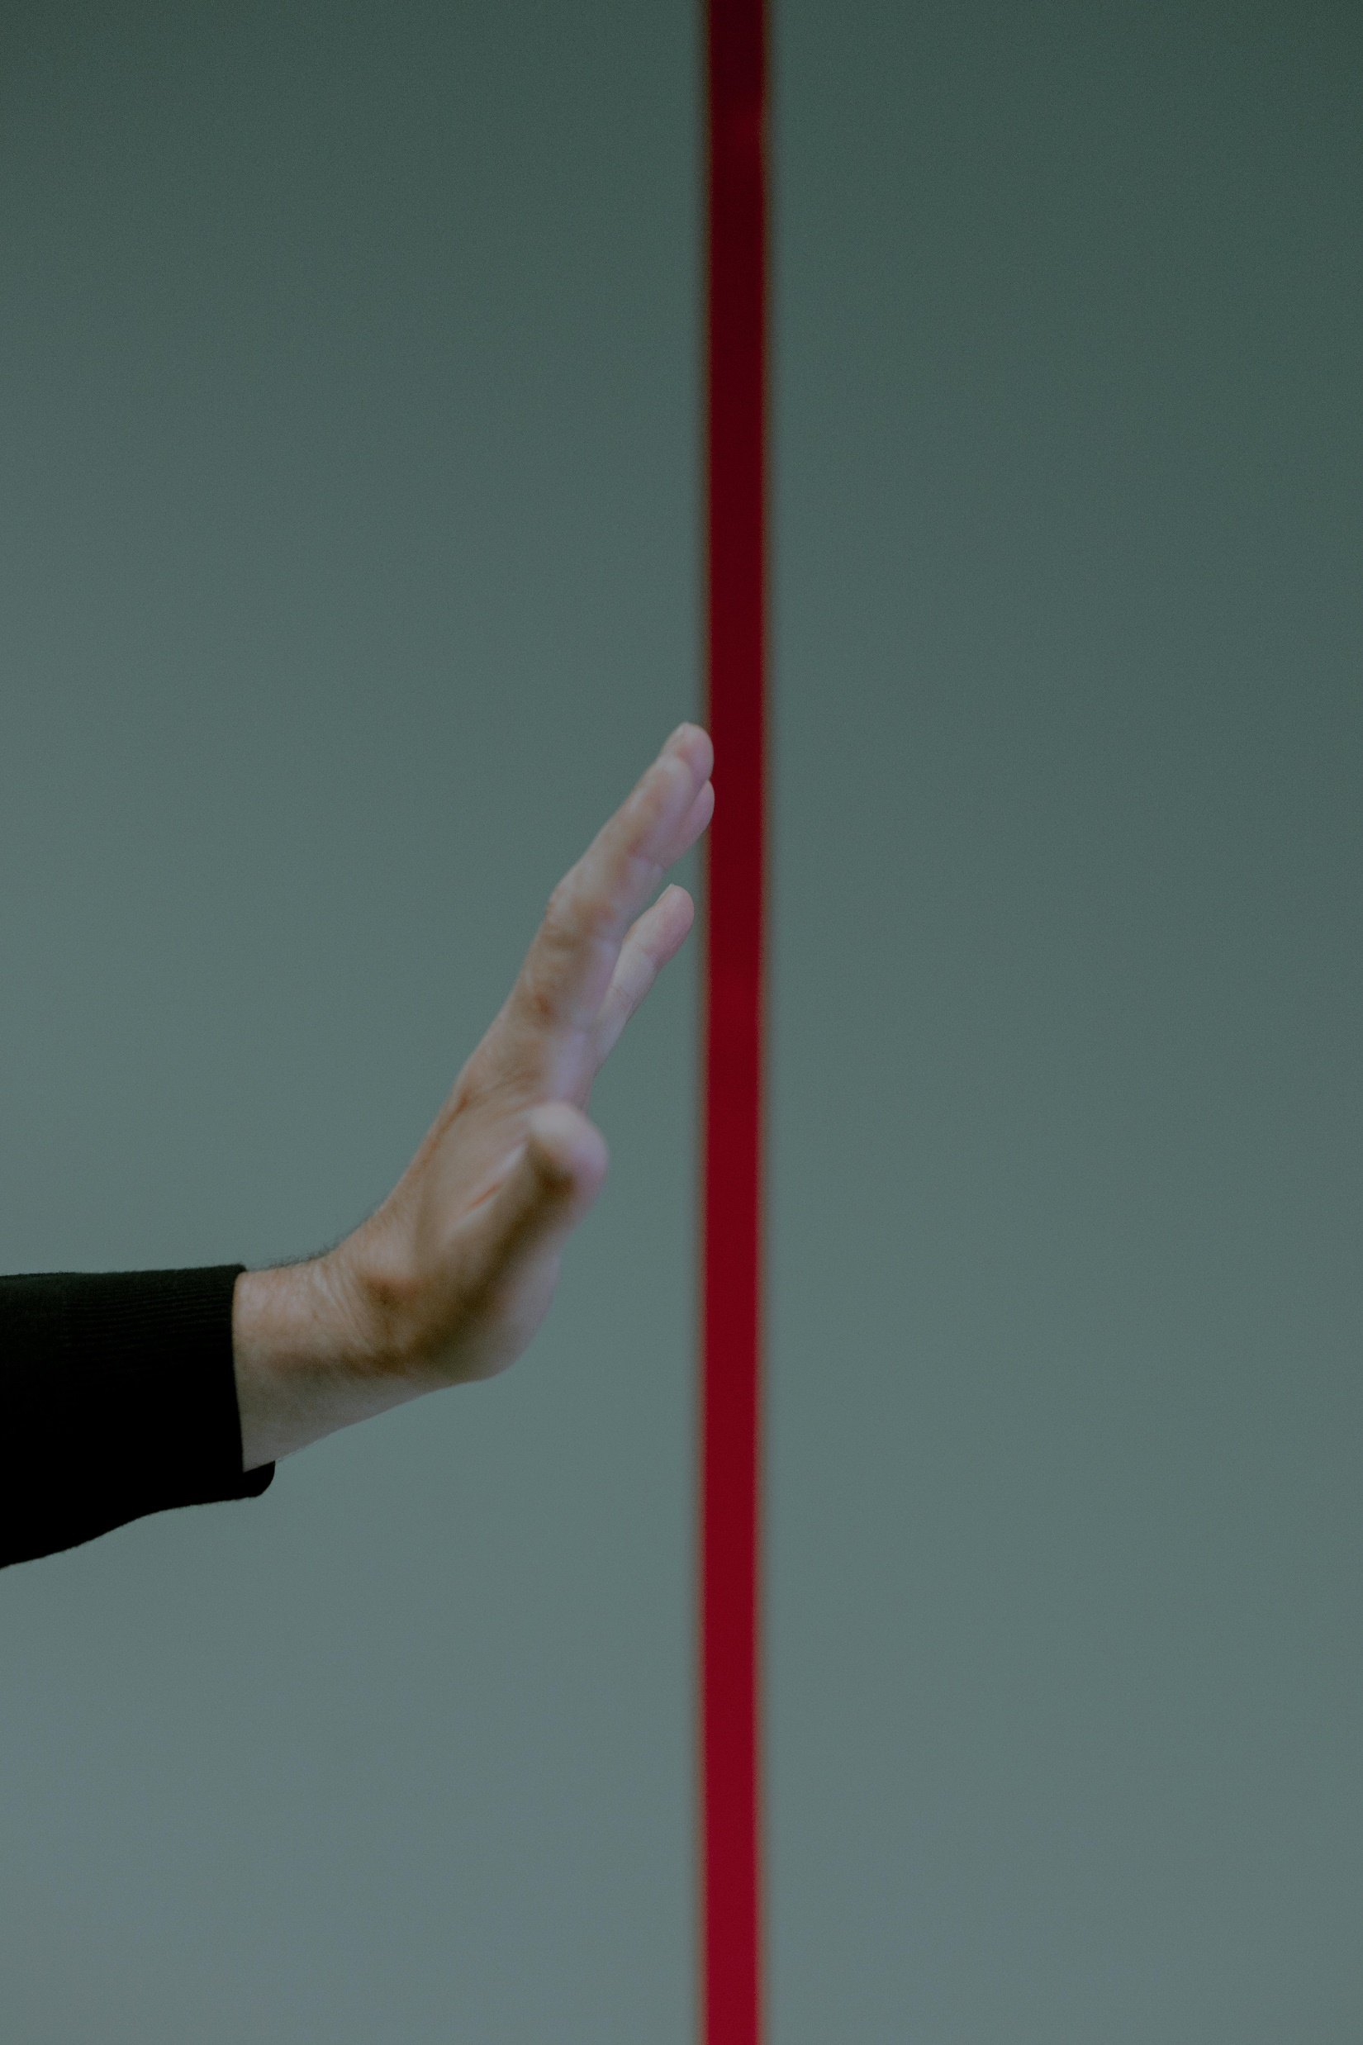
Limitations
The model may require good lightning conditions for best results.
As the model is trained on the coordinates of the hands, fetched during the preprocessing hence, taking hand to area of the frame where less dataset was recorded or on moving hand frequently while testing, the accuracy may degrade.
Sometimes the model may confuse in similar looking gestures hence user may adjust his hand in frame to get desired result and satisfactory accuracy.

Slide 12

Some important works that can be incorporated to our project in future are:
Incorporating more gestures – We can increase the limit of our model to more and even incorporate other popular sign languages.
Deep learning models – Usage of deep learning method like convolutional neural networks can increase the accuracy and robustness of the model to a much greater extent.
Multi-gesture recognition – We can incorporate the ability to recognize multiple gestures simultaneously (e.g. combinations of multiple hand gestures and movements too) to make model more intelligent.
Text conversion – We can make GUIs for converting gesture meanings into the text and phrase the sentences this would increase user experience.
Future Works

Slide 13
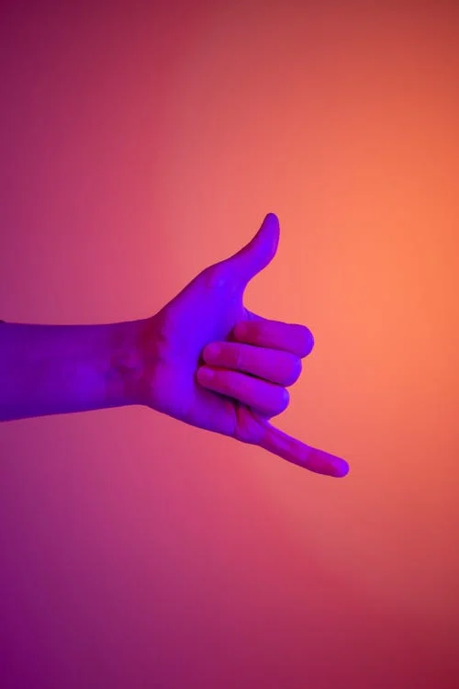
Conclusion
In this project, we successfully developed a system for gesture recognition aimed at interpreting sign language using machine learning and computer vision techniques.
This project serves as a stepping stone towards the development of more inclusive technologies, aiding in communication and improving the quality of life for individuals who rely on sign language.

Slide 14


